Slide 1
Customer Segmentation
By Kenneth Theuri

Slide 2
Business Problem
Customer Behavior is crucial for business as it ensures that organization can make decisions and strategies based on findings.
There are business metrics that businesses can base their strategic decisions: revenue among others

Slide 3
Projects Goal
The projects objectives are as follows:
Key Performance Indicators (KPIs)
Identifying customer segments through RFM Approach

Slide 4
Key Metrics and KPIs
Monthly Revenue and Revenue Rate
Monthly Active Customers
Monthly Order Count
Average Revenue per Order
Monthly Order Average
Revenue per Month for New and Existing Customers
New Customer Ratio

Slide 5
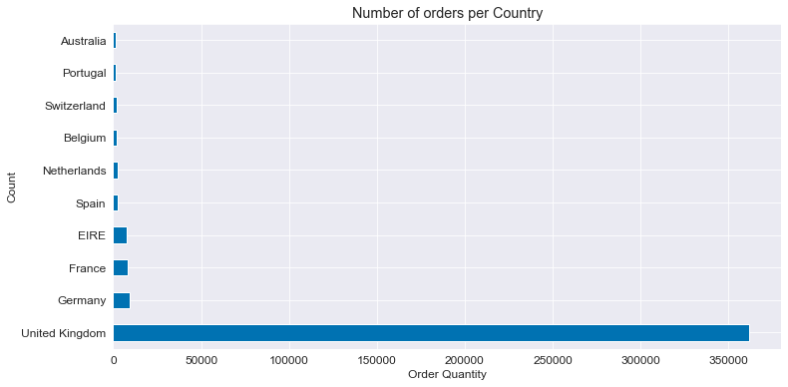
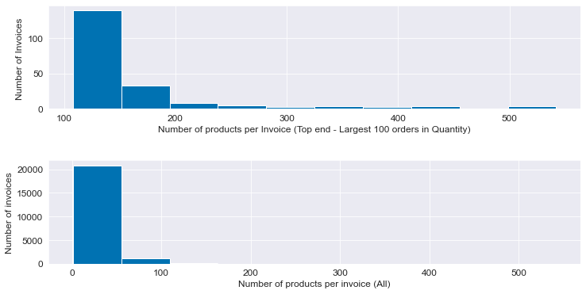
Understanding the Data Visually
The United Kingdom orders a majority of the products
There is a small number of invoices that contains large amount of products in a single invoice.

Slide 6
Key Primary Indicators
The major KPIs are:
Products KPIs – Top Selling Products
Transaction KPIs – Revenue, Order Count, Active Customers
Customer KPIs – Retention, Old vs New Customers

Slide 7
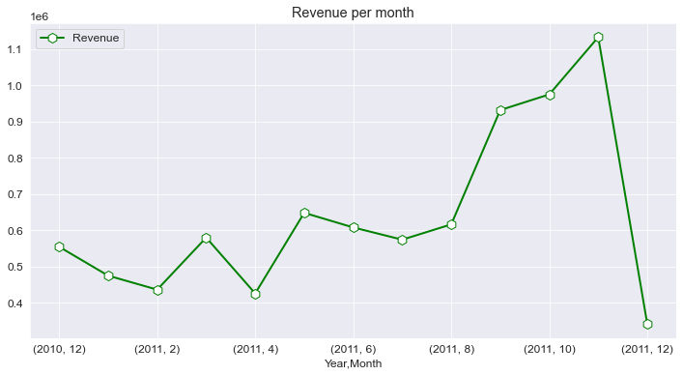
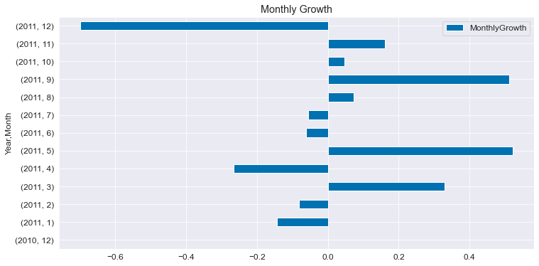
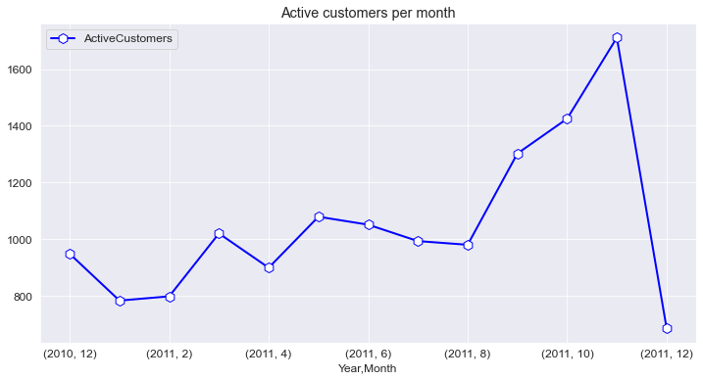
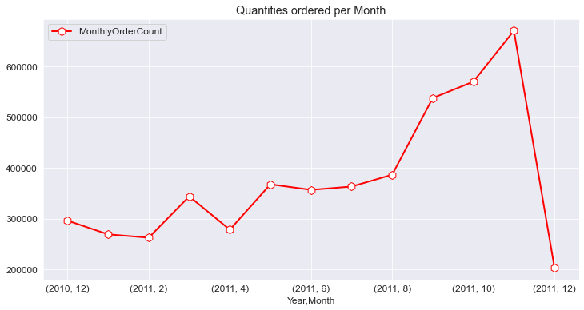
Transaction KPIs

Slide 8
Cont’d
For the revenue, the highest revenue was in November 2011.
For the active customers, the most active customers was in November 2011.
For the quantities ordered, the most quantities ordered per month was in November 2011.
The highest growth rate was in May and September 2011.

Slide 9
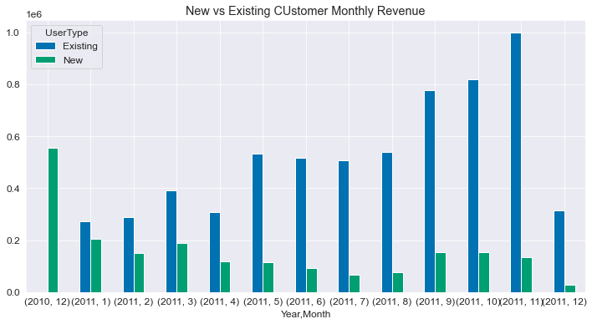
Customer KPIs
The biggest disparity between new and existing customers was in November 2011 due to the high number of existing numbers.
The business is excellent in customer retention.

Slide 10
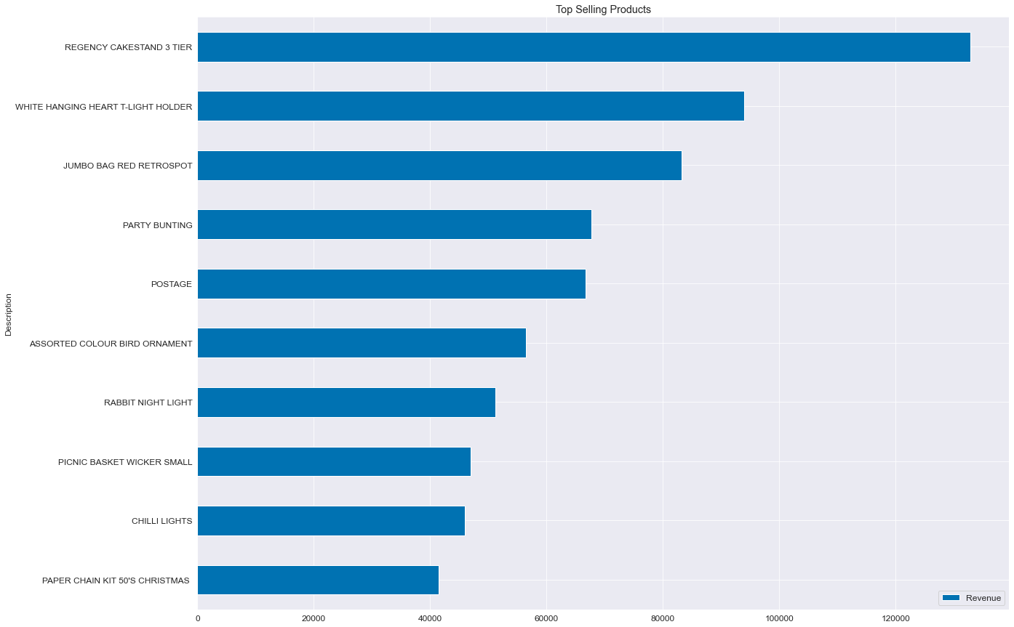
Product KPIs
The three top selling products are: Regency Cakestand, White Hanging heart t-light holder and Jumbo bag red retrospot.
There was no need to consider the lowest selling products as it has negative prices and are discount and commissions.

Slide 11
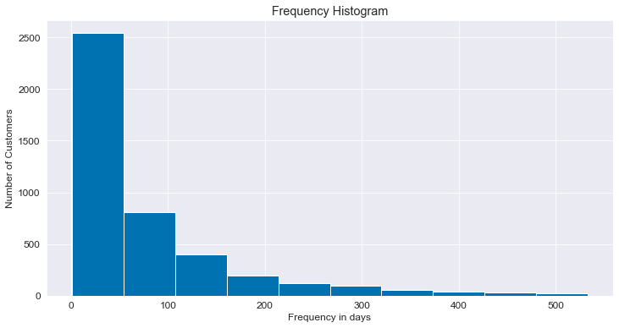
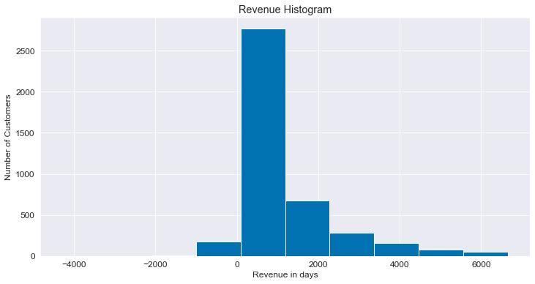
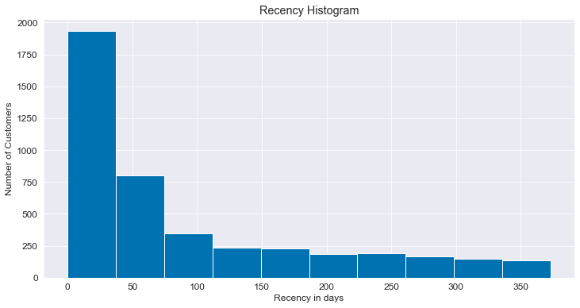
Recency, Frequency, Monetary Value (RFM Approach)
Most customers buy frequently, below 100 days as shown in Frequency
Most customers make a majority of transactions before the 100 days as shown in Recency
Most customers spend most of the money within the first few days as shown in Monetary value

Slide 12
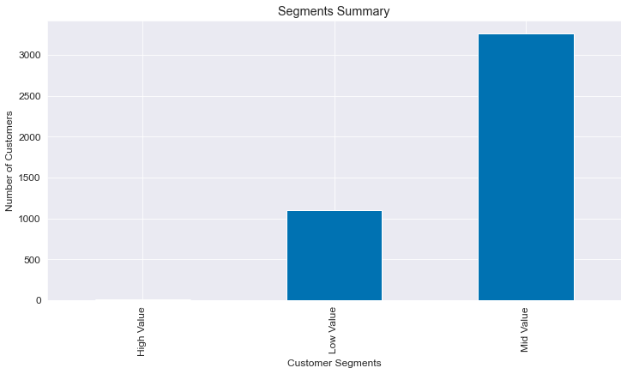
Most of the customers are in the Mid Value Segment. Features of this segment are as follows: medium or inconsistent activity, frequent or infrequent at specific times and varied spending but in the mid scale.
There are some customers on the Low Value Segment. Features are: less active, not very frequent and low spending.
There are no customers on the High Value Segment that has very active, very frequent and those with a great spending profile.

Slide 13
Summary and Conclusions
The business must increase both retention and frequency for the mid value segments to bring the customers closer to the brand so that they can become high value. The business must concentrate on this segment as it has a majority of the customers and has the easiest route to become high value segment.
The business must increase frequency for the low value segment and the business must consider any potential issues around the products.

Slide 14
THANK YOU

